Slide 1
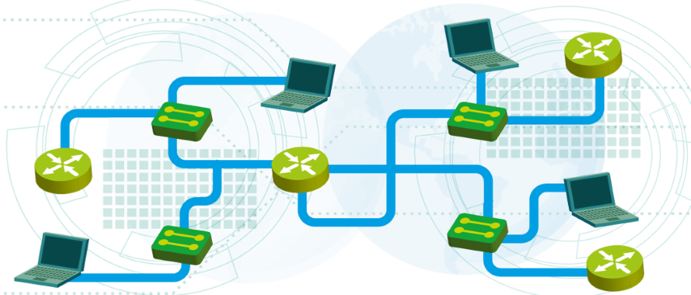
Introduction to Networking
Lecture 1
SoftUni Team
Technical Trainers
Software University
http://softuni.bg

Slide 2
Table of Contents
Basic networking concepts
IP and MAC addresses
Traffic types
OSI and TCP/IP models
Cisco Packet Tracer: Introduction

Slide 3
Basic networking concepts

Slide 4

What is a computer network?
Multiple computers linked together
Why? To communicate and share resources

Slide 5
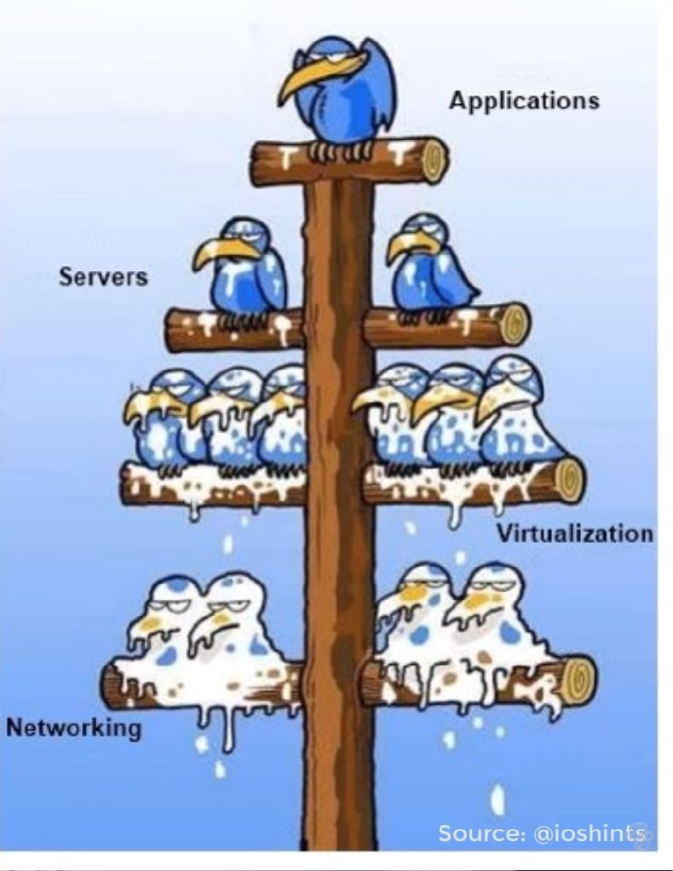
Why computer networking is important
Services, consumed by the users, depend on computer networks
Can be ungrateful and “dirty”
when it works: “You are doing nothing!”
when it doesn’t work: “It is down again!”

Slide 6
How did it start?
ARPANET - The Advanced Research Projects Agency NETwork
Established in 1969
It is the first packet switching network which will use TCP/IP
It was designed for scientific purposes and to share computer resources
ARPANET’s purpose was more academic than military

Slide 7
Common Types of Computer Networks
Local Area Network (LAN)
Wide Area Network (WAN)
Wireless Local Area Network (WLAN)
Storage Area Network (SAN)
Home Area Network (HAN)

Slide 8
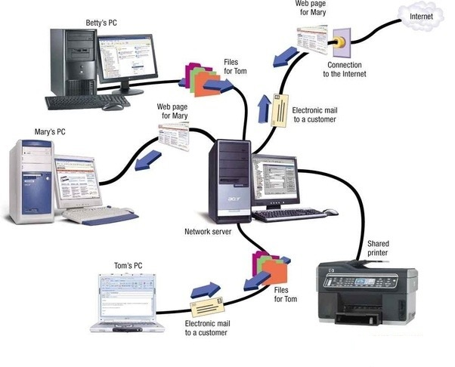
Local Area Network (LAN)
Connects network devices over a relatively short distance
Very useful for sharing resources such as data storage and printers

Slide 9

Wide Area Network (WAN)
Connects multiple LANs together
Extends over a large geographical distance
The Internet is the largest WAN spanning the Earth

Slide 10
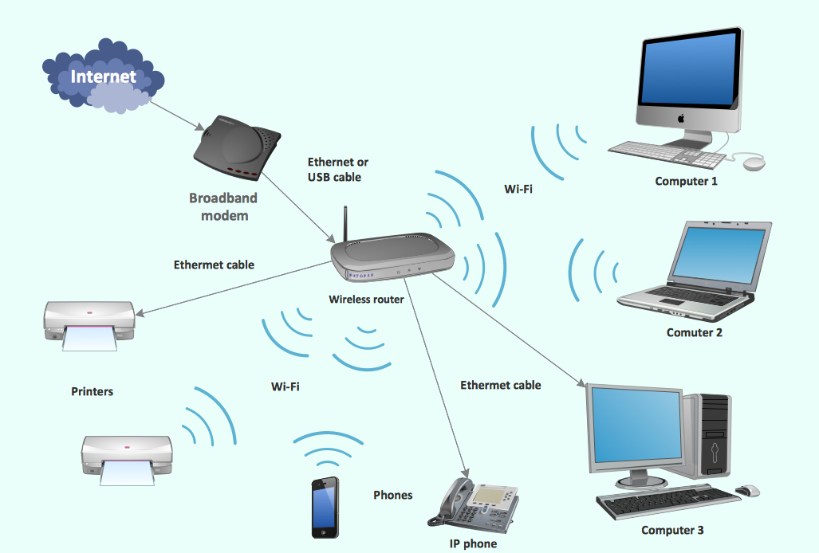
Wireless Local Area Network (WLAN)
Links two or more devices using a wireless distribution method
Operates within limited area

Slide 11
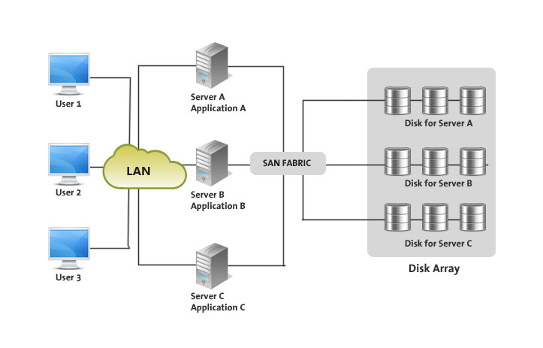
Storage Area Network (SAN)
Provides block-level network access to storage
The OS will see it as a locally attached storage
Common SAN protocols
FC
iSCSI
AoE (ATA over Ethernet)

Slide 12
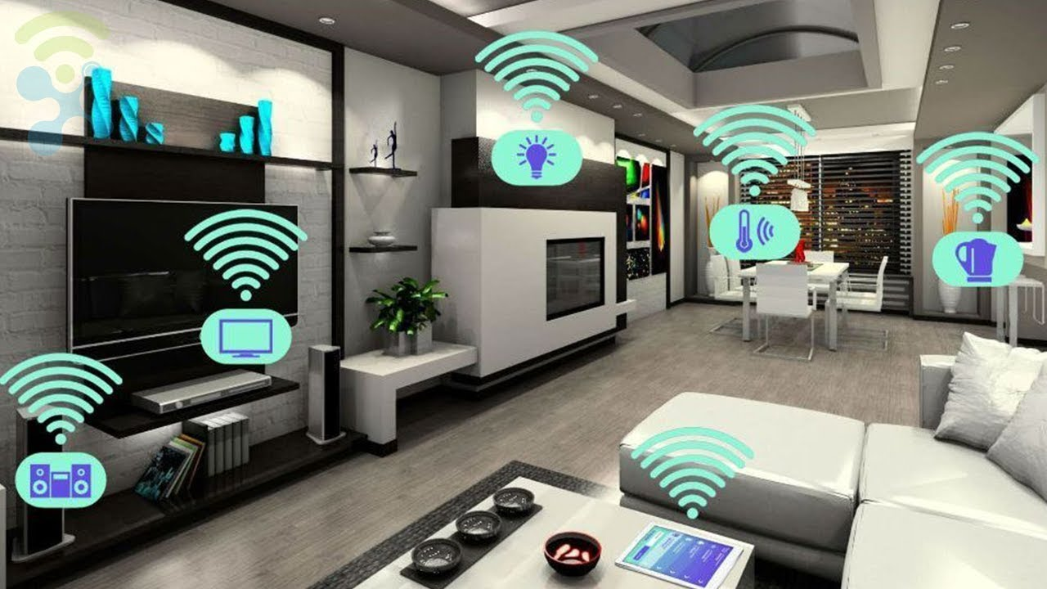
Home Area Network (HAN)

Slide 13
Common Types of Networking Devices
Hub (obsolete, not secure and very slow)
Switch
Router
Modem
Firewall
Bridge (like a Switch, fewer ports)
Repeater (like a Hub, it just amplifies the signal)

Slide 14
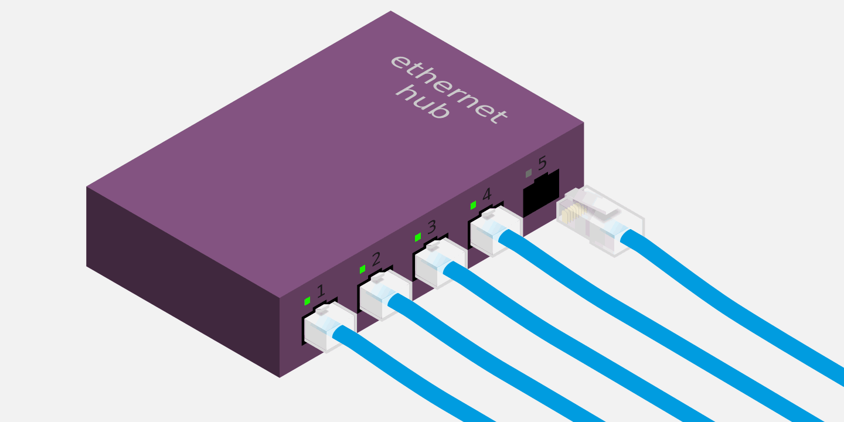
Ethernet Hub
Used to connect multiple network hosts
Works at Layer 1 of the OSI model
Poor security and performance
Obsolete and now replaced by switches

Slide 15
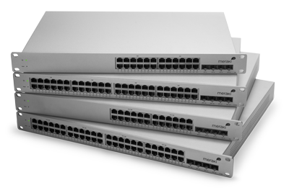
Ethernet Switch
Provides end user connectivity
More intelligent than a hub
Has a MAC address table
Provides Layer 2 functionality (and optionally L3)
VLANs can be configured

Slide 16
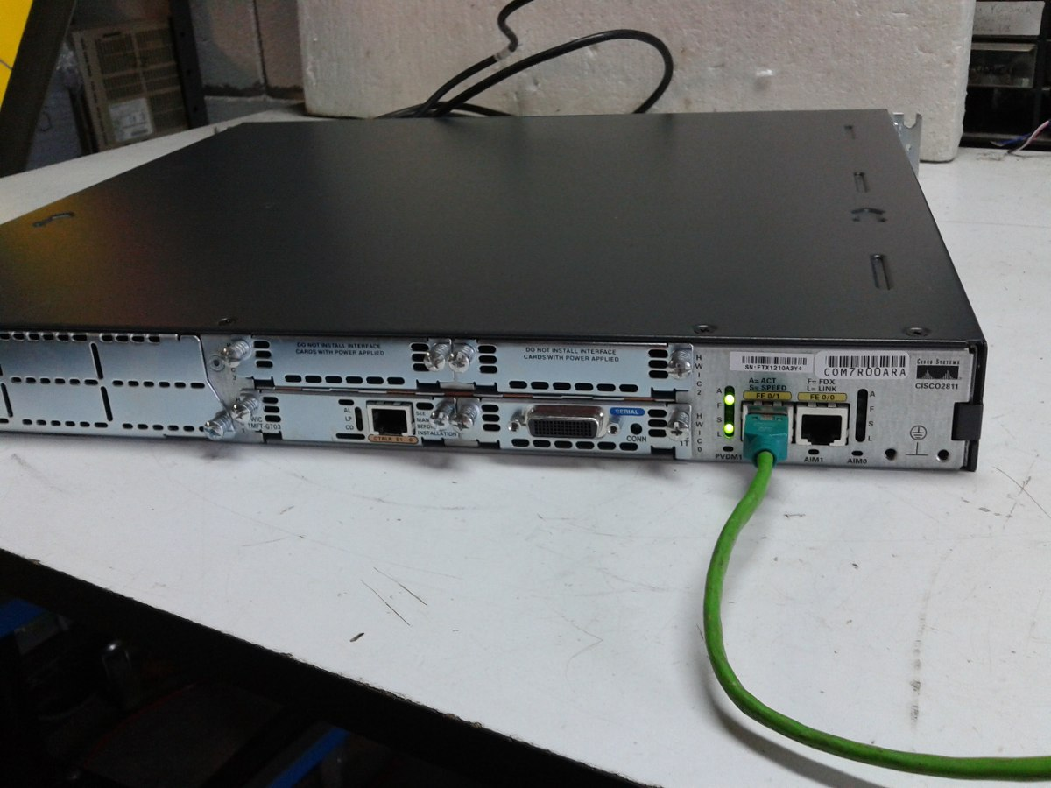
Router
Sends packets from one network to another
Provides Layer 3 functionality
Uses IP addresses to transfer packets
“Traffic police” - directs the network traffic to different destinations

Slide 17
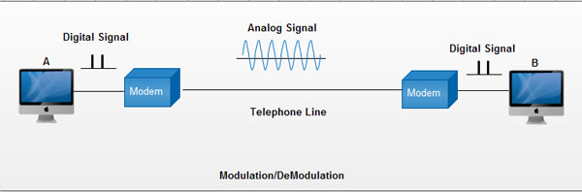
Modem
Digital to analog (and vice versa) signal conversion: MOdulation/DEModulation

Slide 18
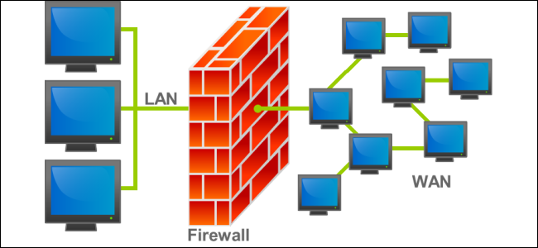
Firewall
Monitors the network traffic and makes decisions what to allow and what to block
Protects a computer network from unauthorized access
It may be hardware device, a software, or a combination of the two

Slide 19
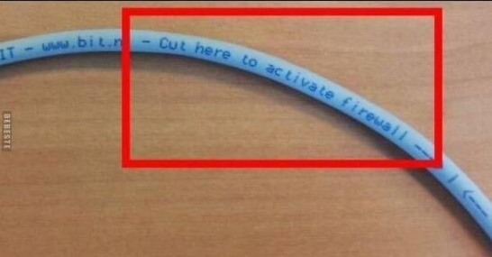
Firewall (2)

Slide 20
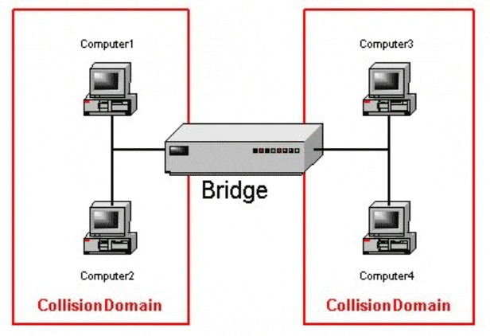
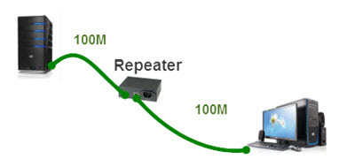
Bridge and repeater
Bridge
Similar to a Switch
Works at Layer 2
Repeater
Similar to a Hub
Works at Layer 1

Slide 21
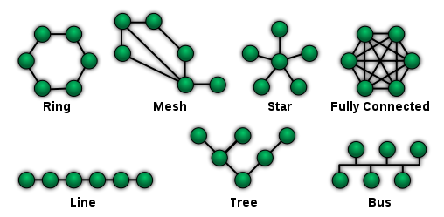
Types of Network Topologies
Physical vs logical topologies
(extended) star is the most common
Hybrid topologies

Slide 22
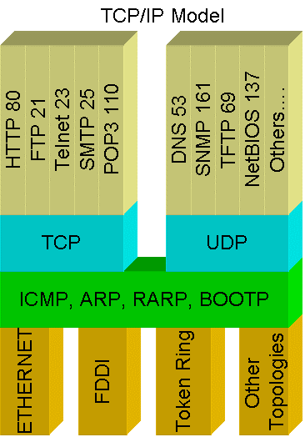
Networks Protocols
Define a common format and set of rules for exchanging messages between network devices
Common protocols:
HTTP
FTP
SMTP
DNS
DHCP
RDP

Slide 23
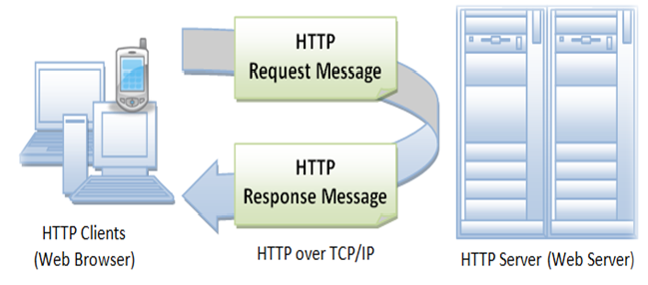
Hyper text transfer protocol (HTTP)
Set of rules to transfer files - text, images, sound, video and other multimedia on the World Wide Web
This is how our browsers talk to web servers

Slide 24
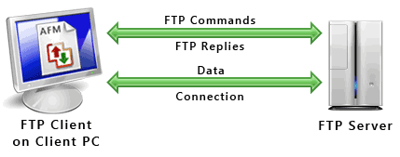
File Transfer Protocol (FTP)
Transfer files from one computer to another
You can connect anonymously or with username and password

Slide 25
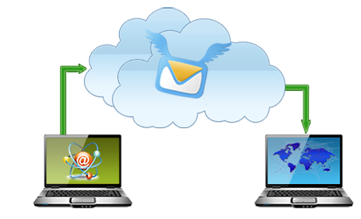
Simple Mail Transfer Protocol (SMTP)
Can be used for:
Server-to-server email transport
Client-to-server email transport

Slide 26
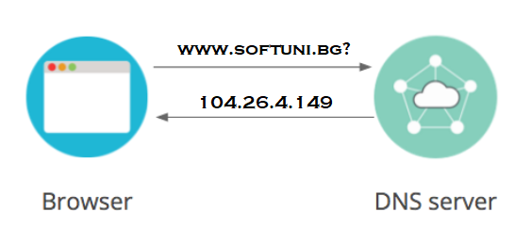
Domain Name System (DNS)
Translates domain names into IP addresses (and much more)
It is hierarchical and distributed database

Slide 27
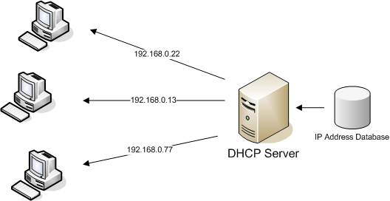
Dynamic Host Configuration Protocol (DHCP)
Allows a computer to get an IP address from a special server
Uses client-server architecture

Slide 28
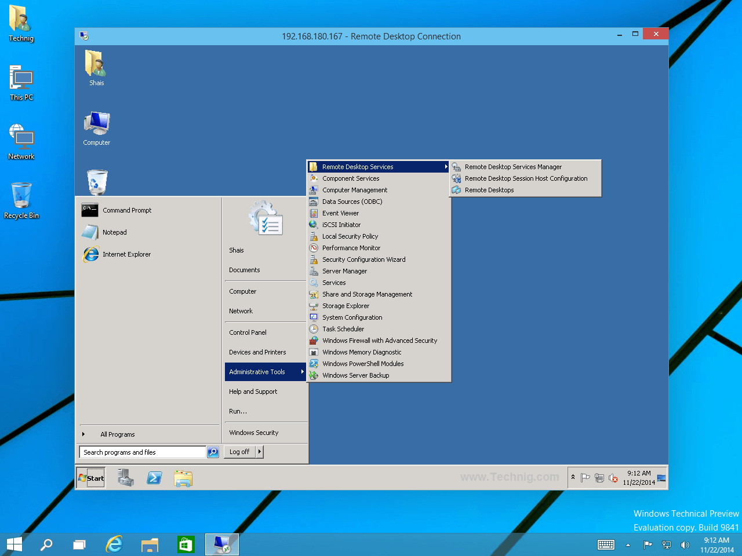
Remote Desktop Protocol (RDP)
Provides a graphical interface to connect to another computer over the network
Can also transfer other resources between the local and remote system, like audio, disk drives and clipboard

Slide 29
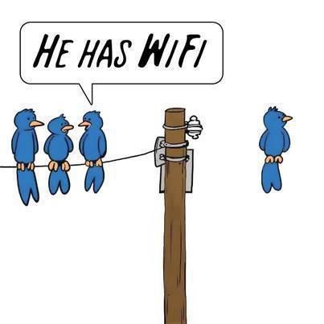
Common Types of Media
“X”TP (“something” Twisted Pair). The “twist” idea introduced by Alexander Bell in 1881
Coaxial Cable
Fiber Optic
Wireless

Slide 30
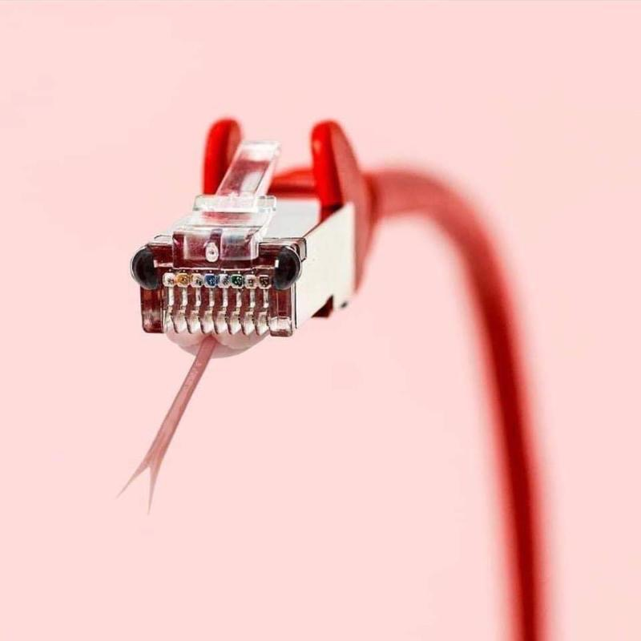
Let’s talk about cables…

Slide 31
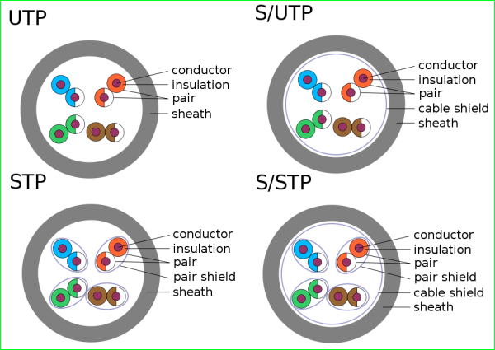
“X”TP (“something” Twisted Pair)
UTP – Unshielded Twisted Pair
S/UTP – Screened UTP
STP – Shielded Twisted Pair
S/STP - Screened STP

Slide 32
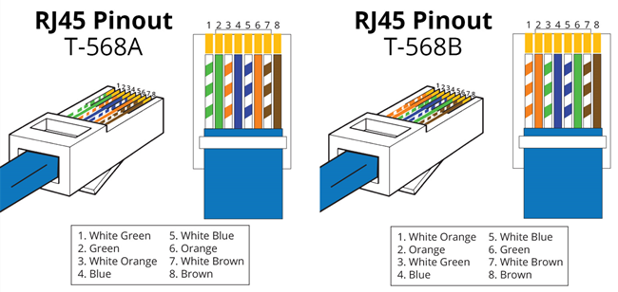
EIA/TIA Standards
EIA = Electronic Industries Alliance TIA = Telecommunications Industry Association
T568B is most frequently used

Slide 33
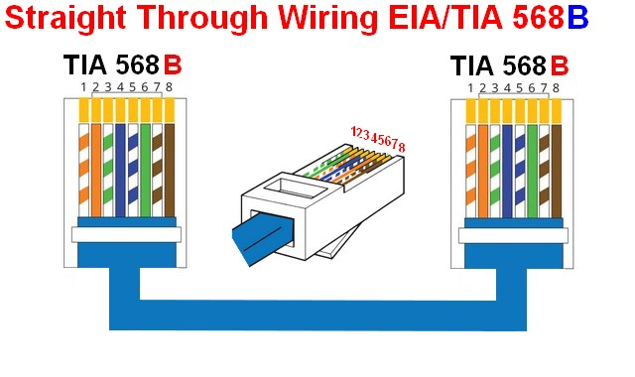
Straight-through Cable
Pin 1 → Pin 1
Pin 2 → Pin 2, etc.
Most commonly used to connect devices from different types:
Host to switch
Switch to router

Slide 34
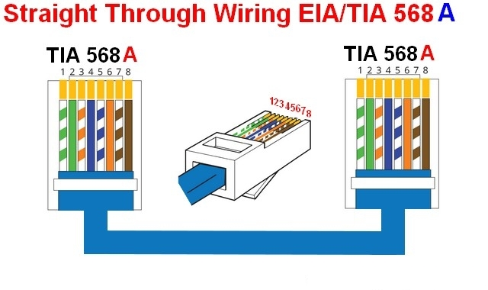
Straight-through Cable (2)
A “straight” cable can be either:
T568B to T568B OR
T568A to T568A

Slide 35
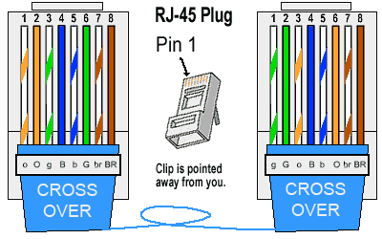
Crossover Cable
Pin 1 → Pin 3
Pin 2 → Pin 6, etc.
Most commonly used to connect two hosts directly

Slide 36
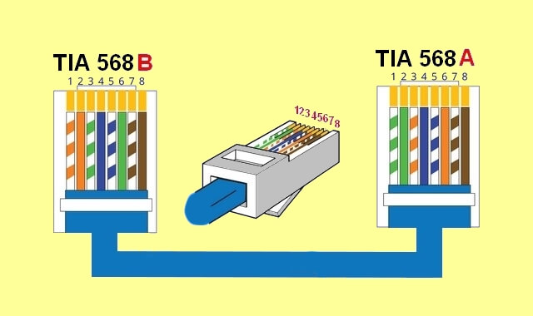
Crossover Cable (2)
It is T568B from one side and T568A from the other
Used to connect devices from the same type:
Host to host
Router to router
Host to router (yes, no mistake)

Slide 37

Auto MDI/MDIX
MDI: Medium Dependent Interface – standard wiring for end stations
MDIX: Medium Dependent Interface Crossover - standard wiring for hubs and switches
The good news! Auto MDI/MDIX automatically detects the required cable connection type and configures the connection appropriately

Slide 38
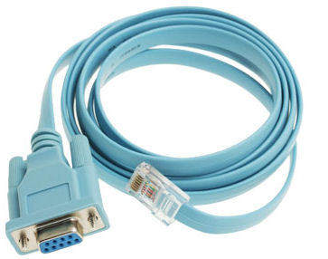
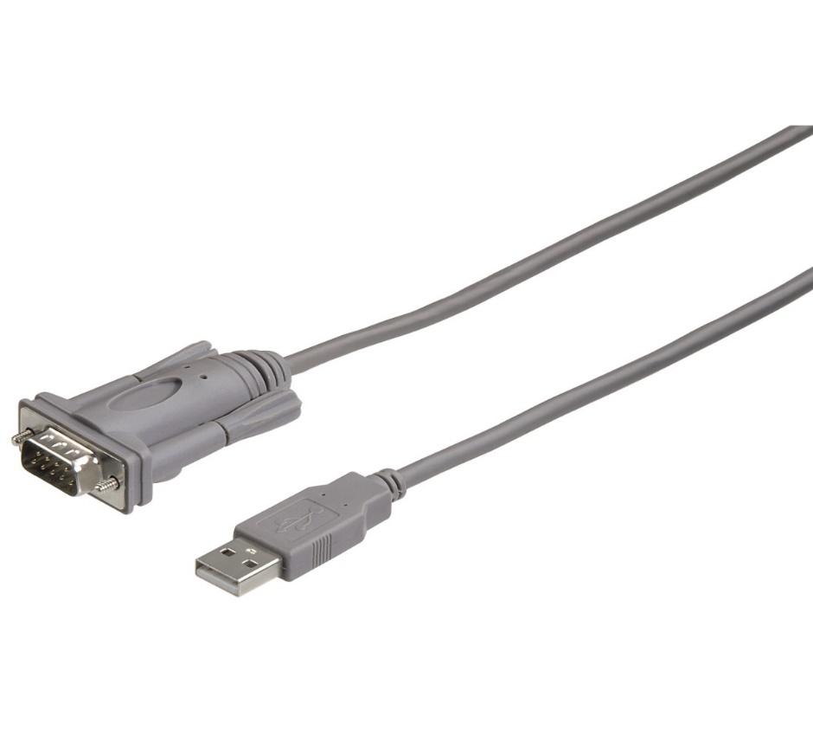
Console Cable
Used to connect to the console of a networking device (switch, router)
Usually a USB to Serial adapter is also required

Slide 39
IP and MAC addresses

Slide 40
IP Addresses
Known as logical address
Can be assigned to network and end devices
Essential part in routing
Four bytes (octets), separated with “ . “ Example: 1.3.2.8

Slide 41
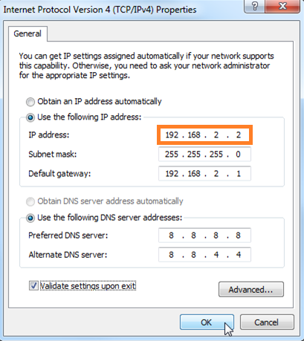
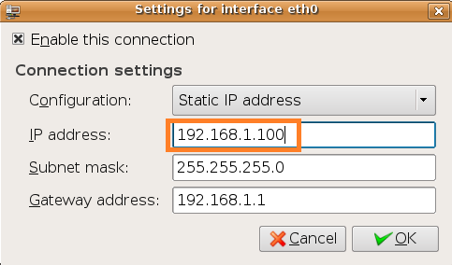
IP Addresses (2)

Slide 42
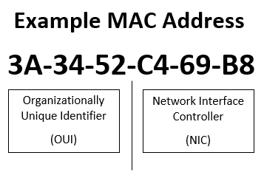
MAC Addresses
Known as physical address
Unique identifier assigned to network interfaces
48 bits or 6 bytes in a hexadecimal format (discussed later in the course)
Can you change it?

Slide 43
What is a MAC Address Used for?
Host-to-host communication
Device Identification and tracking
“Static” IP Assignment (Matched MAC -> receive IP)
MAC Address Filtering
MAC Address Authentication (ISPs use it, for example)

Slide 44
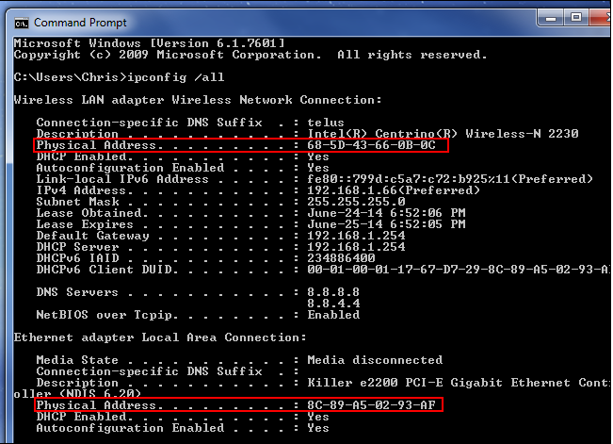
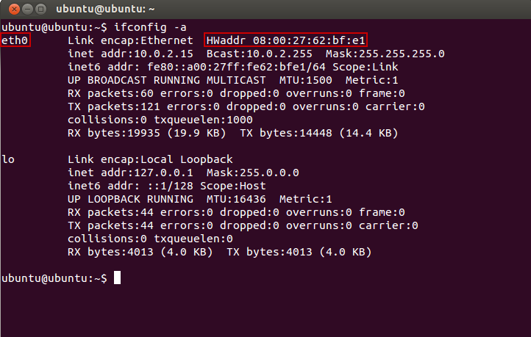
Example of MAC Address
Windows
Linux

Slide 45
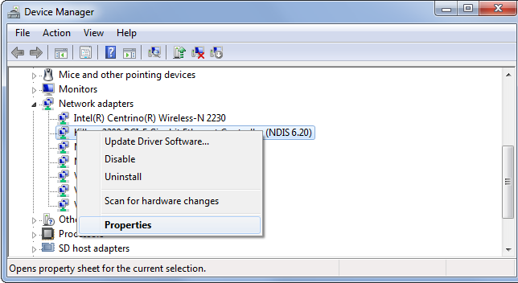
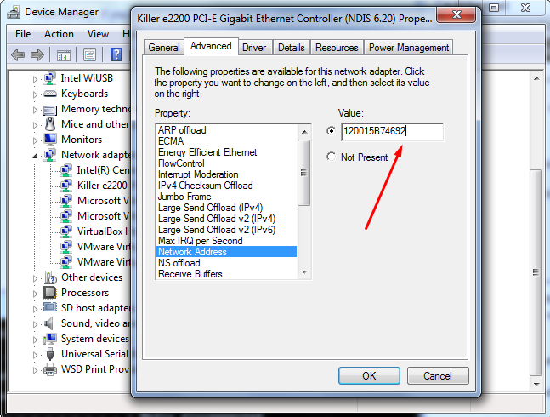
How to Modify a MAC Address in Windows

Slide 46
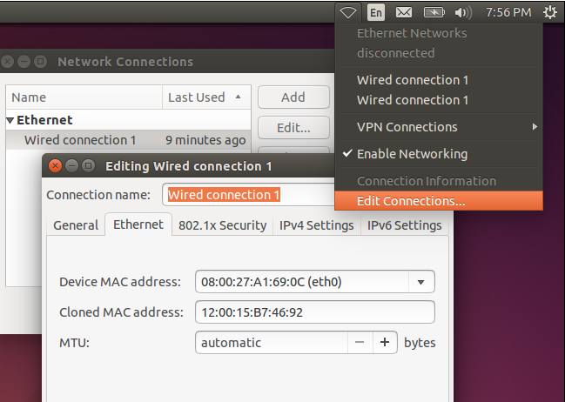
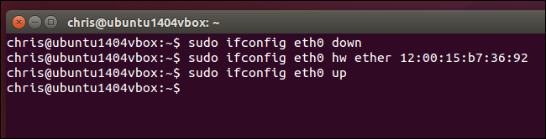
How to Modify a MAC Address in Linux
The new MAC address

Slide 47
Traffic Types

Slide 48
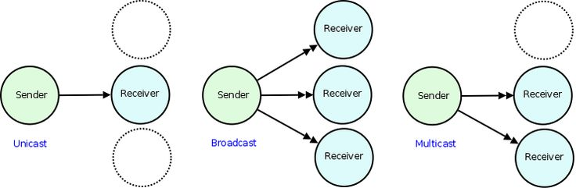
Types of traffic

Slide 49

Unicast

Slide 50
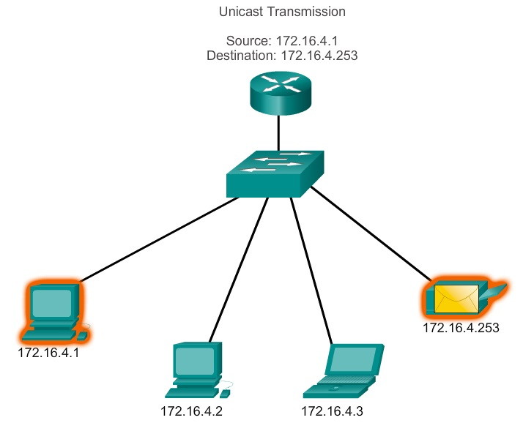
Unicast (2)
Single destination identified by a unique address
Used in host-to-host or host-to-server communication

Slide 51

Broadcast
Send a message to all recipients simultaneously
Used in DHCP, ARP (will be discussed later)

Slide 52
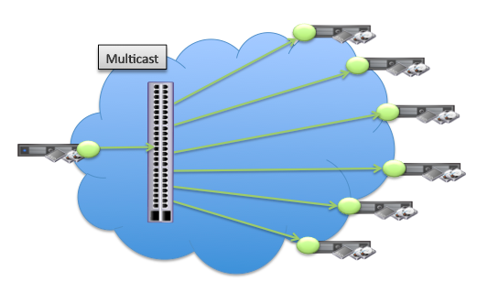
Multicast
Transmit a single message to a group of recipients
One-to-many or many-to-many distribution
Examples:
one person is talking on Skype with two other people
sending e-mail message to a mailing list
audio/video streaming

Slide 53
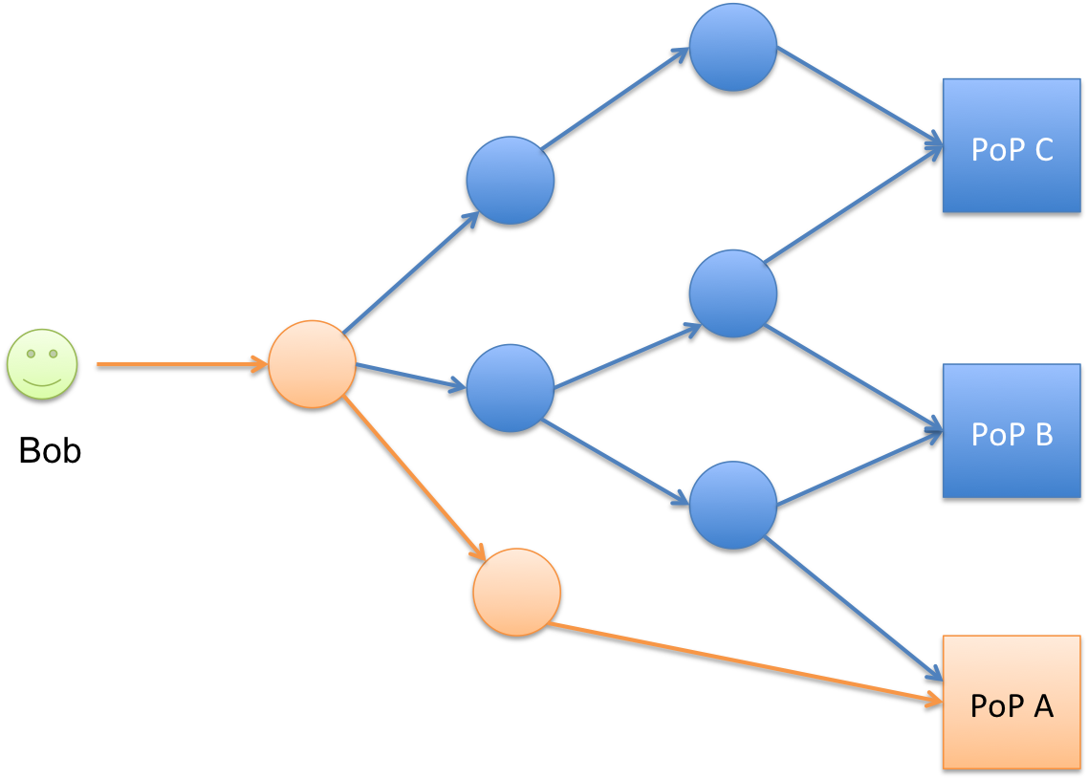
Anycast
Traffic from a single sender is routed to the nearest node in a group of potential receivers
Advantages:
better speed/performance
enhanced reliability
Disadvantages:
more difficult to implement and troubleshoot
not supported by all protocols

Slide 54
OSI and TCP/IP models

Slide 55
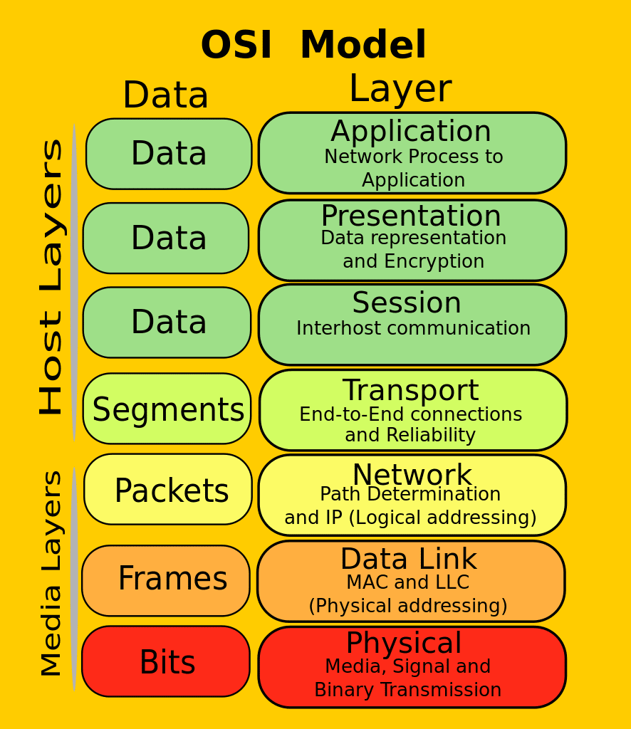
OSI Model
OSI = Open Systems Interconnection
Why?
Organizes the information
Simplifies learning
Standards for the vendors
Easier troubleshooting
Protocol Data Unit (PDU) – different data format at each layer

Slide 56
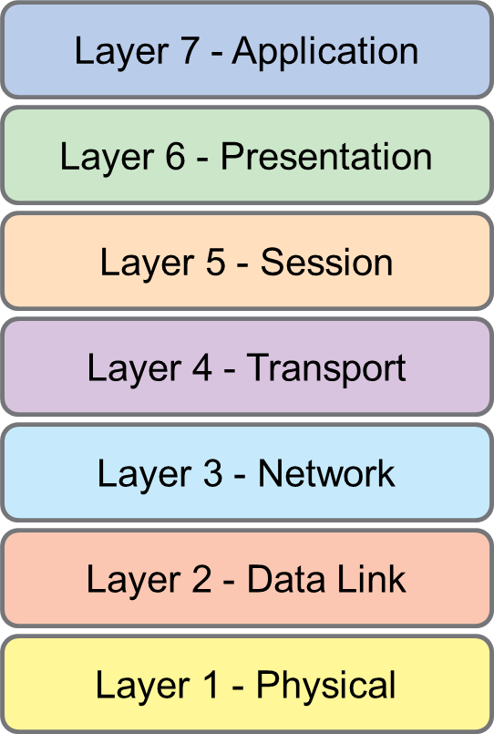
Layer 1 - Physical
The first and lowest layer
Transmitting raw bits
Wiring standards
Devices: hubs, repeaters, modems, cabling, connectors
Protocols: USB, Infrared, Bluetooth

Slide 57
Layer 2 – Data Link
Switching functions
MAC addresses
Devices: switch, bridge, NIC
Protocols: VLAN, ARP, LLDP, CDP, STP

Slide 58
Layer 3 – Network
Routing functions
IP addresses
Devices: router, L3 switch
Protocols: IP, ICMP (ping), RIP, OSPF, EIGRP, GRE, etc.

Slide 59
Layer 4 – Transport
Provides “host-to-host communication”
Services:
connection-oriented vs connection-less
reliability (ACK, NACK)
flow control
multiplexing (port numbers)
Protocols: TCP, UDP

Slide 60
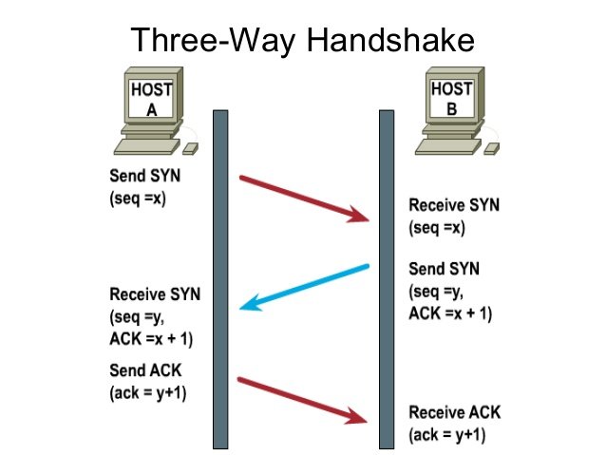
TCP Three-Way Handshake
This is how TCP creates a connection over an IP network
a.k.a. “SYN, SYN-ACK, ACK” handshake

Slide 61
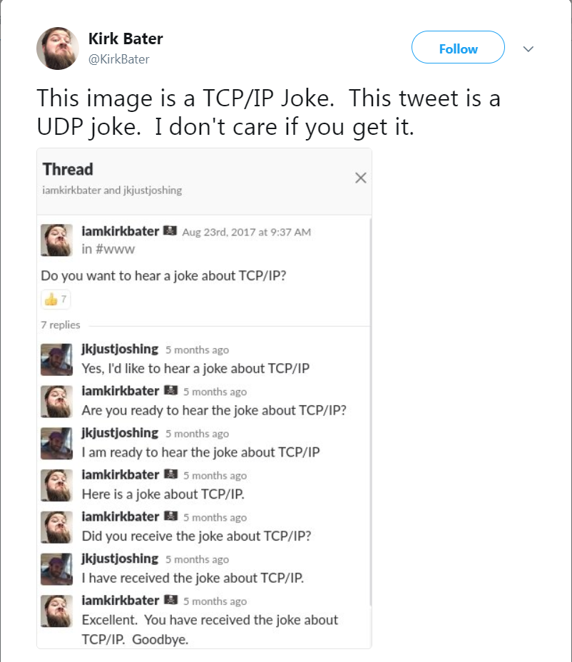
TCP/UDP Twitter joke

Slide 62
Layer 5 – Session
Opening, closing and managing a session
Services:
Authentication
Authorization
Session restoration
Protocols: PPTP, L2TP, NetBIOS, RPC

Slide 63
Layer 6 – Presentation
Sometimes called syntax layer
Acts as data translator for the network
Services:
data conversion
compression
encryption/decryption

Slide 64

Layer 7 – Application
End-user interaction with the network
Protocols: HTTP(s), FTP, SMTP, Telnet, SSH, RDP

Slide 65
Mnemonics for the OSI Model
All
People
Seem
To
Need
Data
Processing
Away
Pizza
Sausage
Throw
Not
Do
Please

Slide 66
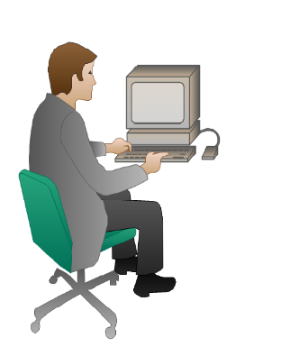


Data Flow in the OSI Model

Slide 67

Data Flow in the OSI Model (2)

Slide 68
Encapsulation and decapsulation
Encapsulation
Each layer adds its own header (and trailer)
During the process, the packet goes down through the layers
Decapsulation
Each layer removes the corresponding header (and trailer)
During the process, the packet goes up through the layers

Slide 69

The TCP/IP Model
Four-layer conceptual model similar to the OSI
Known as the Department of Defense (DoD) model
Why two models?
They were both created independently

Slide 70

OSI and TCP/IP Models Comparing

Slide 71
Cisco Packet Tracer - Introduction
DEMO

Slide 72

Summary
Basic networking concepts
IP and MAC addresses
Traffic types
OSI and TCP/IP models
Cisco Packet Tracer – Introduction
…
…
…

Slide 74












SoftUni Diamond Partners

Slide 75


Educational Partners

Slide 76
Trainings @ Software University (SoftUni)
Software University – High-Quality Education, Profession and Job for Software Developers
softuni.bg, about.softuni.bg
Software University Foundation
softuni.foundation
Software University @ Facebook
facebook.com/SoftwareUniversity
Software University Forums
forum.softuni.bg
Notes:
76

